Slide 1

Module II
Master of Computer Applications
Minor Specialization – Agile Software Development Approaches
Subject code – 23MCAM21
Assistant Professor – Mr. Rahul Pawar
Agile and Its Significance

Slide 2

Unit : 2
Agile Development
Agile development methods apply time-boxed iterative and evolutionary development, adaptive planning, that promotes the evolutionary delivery, and include other values and practices that encourage agility rapid and flexible response to change.
If agile methods have a motto, it is embrace change.
If agile methods have a strategic point, it is maneuverability.

Slide 3
Unit : 2
However, short time-boxed iterations with adaptive, evolutionary refinement of plans and goals is a basic practice various methods share.
In addition, they promote practices and principles that reflect an agile sensibility of simplicity, lightness, communication, self-directed teams, programming over documenting, and more.

Slide 4
Unit : 2
Classification of Methods
Having raised the issue of variations in methods, one classification is their degree of ceremony the amount of method weight in terms of documentation, formal steps, review, and so forth.
Another classification is their cycles the number and length of iterations.
For example, single-pass waterfall has no iterations; at the other end, an Evo project could have very many one iteration per week.

Slide 5
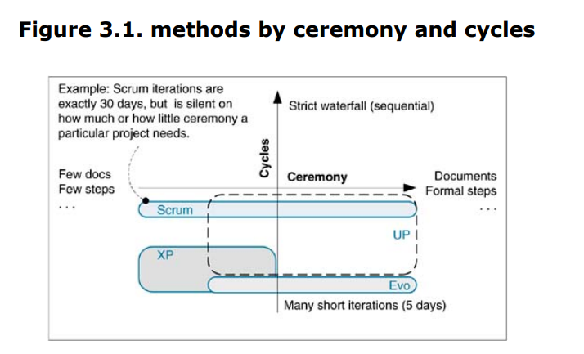
Unit : 2

Slide 6
Unit : 2
As hinted in Figure 3.1, XP recommends 14 weeks, and the UP 26 weeks.
Some would say the lower left quadrant (many short iterations, low ceremony) describes the agile methods, but this is not quite accurate.
For example, Scrum is silent on the question of ceremony or more precisely leaves the question to the discretion of the team.

Slide 7
Unit : 2
The Agile Manifesto and Principles
In 2001 a group interested in iterative and agile methods (coining the term) met to find common ground.
Out of this came the Agile Alliance (www.agilealliance.com) with a manifesto and statement of principles.
Most of the many concrete practices described throughout this book reflect these principles.
The Agile project management is guided by these principles.

Slide 8
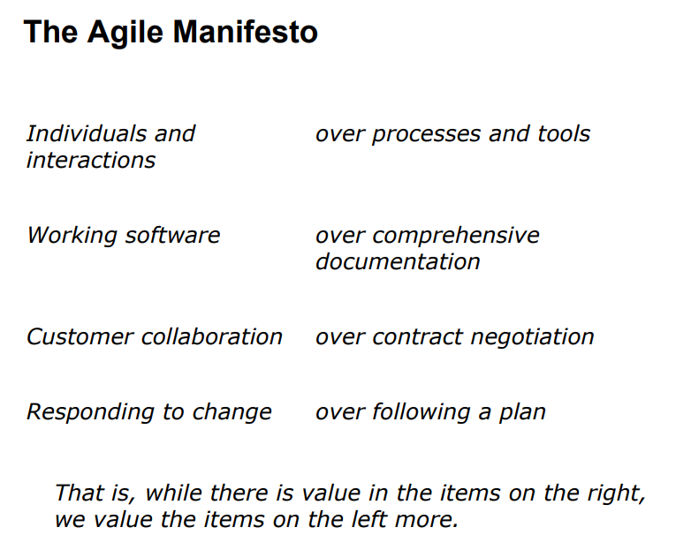
Unit : 2

Slide 9
Unit : 2
The Agile Principles
Our highest priority is to satisfy the customer through early and continuous delivery of valuable software.
Welcome changing requirements, even late in development. Agile processes harness change for the customer's competitive advantage.
Deliver working software frequently, from a couple of weeks to a couple of months, with a preference to the shorter time scale.
Business people and developers must work together daily throughout the project.

Slide 10
Unit : 2
5. Build projects around motivated individuals. Give them the environment and support they need, and trust them to get the job done.
6. The most efficient and effective method of conveying information to and within a development team is face-to-face conversation.
7. Working software is the primary measure of progress.
8. Agile processes promote sustainable development.

Slide 11
Unit : 2
9. The sponsors, developers, and users should be able to maintain a constant pace indefinitely.
10. Continuous attention to technical excellence and good design enhances agility.
11. Simplicity the art of maximizing the amount of work not done is essential.
12. The best architectures, requirements, and designs emerge from self organizing teams.
13. At regular intervals, the team reflects on how to become more effective, then tunes and adjusts its behavior accordingly.

Slide 12
Unit : 2
Agile Project Management
The Scrum and XP concepts include specific agile project management practices for those methods.
Other authors present generalizations with common themes: manager promotes the vision, more communication, avoid command-control, and so on.
This section summarizes two well-known descriptions.

Slide 13
Unit : 2
Agile Project Management
Jim Highsmith, an Agile Alliance founder and creator of the Adaptive Software Development method, summarizes nine principles for the agile project manager :
1. Deliver something useful to the client; check what
they value.
2. Cultivate committed stakeholders.
3. Employ a leadership collaboration style.
4. Build competent, collaborative teams.
5. Enable team decision making.

Slide 14
Unit : 2
Agile Project Management
6. Use short time-boxed iterations to quickly deliver
features.
7. Encourage adaptability.
8. Champion technical excellence.
9. Focus on delivery activities, not process compliance activities.

Slide 15
Unit : 2
Augustine and Woodcock, two managers with experience in XP-oriented projects, recommend six practices [AW02]:
Guiding Vision
Establish a guiding vision for the project and continuously reinforce it through words and actions.
2. Teamwork & Collaboration
Facilitate collaboration and teamwork through relationships and community.

Slide 16
Unit : 2
3. Simple Rules
Establish and support the team's set of guiding practices, such as Scrum or XP.
4. Open Information
Provide visible and open access to project management and other information.
5. Light Touch
Apply just enough control to foster emergent behavior in a self-directed team.
6. Agile Vigilance
Reinforce the vision, follow or adapt the rules, listen to the people.

Slide 17
Unit : 2
Embrace Communication and Feedback
If the agile Prime Directive is embrace change, a close second is embrace communication and feedback.
The manifesto and principles, and agile methods have a theme of working to increase communication, especially face-to-face conversation.
This is illustrated in practices such as the daily Scrum meeting and XP's requirement to have on-site customers sitting full-time in the common project room.

Slide 18
Unit : 2
Agile methods are adaptive, requiring feedback to guide direction
Beyond just conversation, they seek out early and frequent feedback through early testing, early demos, and much more

Slide 19
Unit : 2
Simple Practices and Project Tools
Agile Principle 11 is Simplicity is essential. Most agile methods embrace do the simplest thing that could possibly work an XP aphorism
This applies not only to software design, but to all project practices
Most agile methods promote a "low-tech, high-touch“ approach to project and management tools. Of course, low-tech is relative: If the simplest thing that could possibly work is a Web tool, then so be it.

Slide 20
Unit : 2
Empirical vs. Defined & Prescriptive Process
A defined process (also known as a prescriptive process) has many predefined and ordered activities to be followed during development.
Defined processes are suitable for predictable manufacturing domains.
Empirical processes are used for high-change and unstable domains; rather than many sequenced activities, they are based on frequent measurement and dynamic response to variable events.
This approach is reflected in Agile Principles 12 and 13.

Slide 21
Unit : 2
For example, Scrum is silent on the activities of an iteration, other than the daily Scrum meeting as the measurement and response mechanism.
The UP, on the other hand, strikes a middle way; it lists common activities (e.g., Write Release Notes), but the team is welcome to ignore or do them in any order.
An agile method or project lies on a continuum of more or less empirical, driven by need.

Slide 22
Unit : 2
Agile methodologists understand that the degree of "method weight" and predefinition of ordered activities are functions of the project type.
A medical device under FDA approval requires more formal, predefined activities

Slide 23
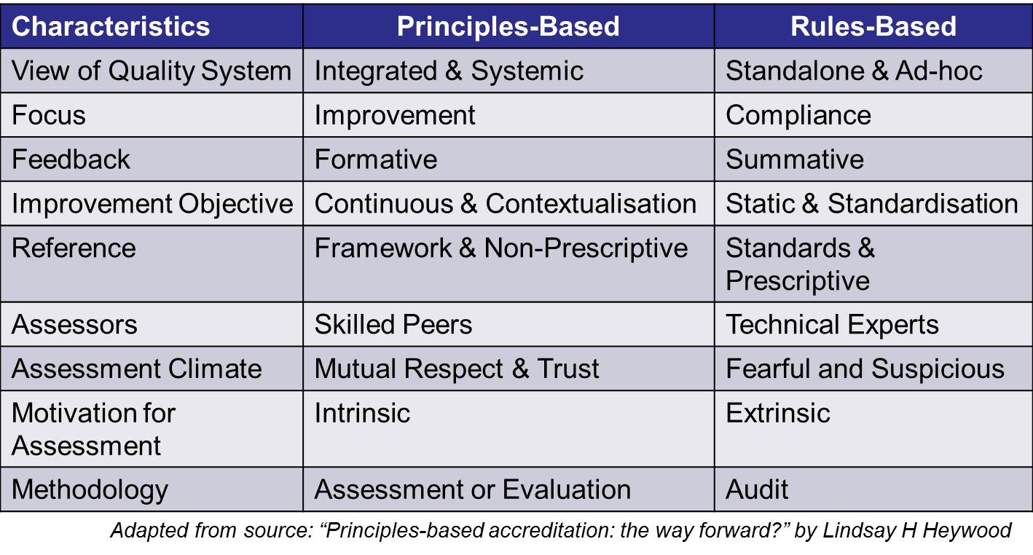
Unit : 2
Principle-Based versus Rule-Based

Slide 24
Unit : 2
Principle-Based versus Rule-Based
Similar to empirical versus prescriptive methods, a related way to describe agile methods is as more principle-based than rule-based.
Rather than a predefined set of rules regarding the many roles, team organization, responsibilities, relationships, and activities, the team and manager are primarily guided by the principles embodied in the Agile Manifesto and Principles.
Agile project management is more than a set of practices it is a mindset.

Slide 25
Unit : 2
Sustainable Discipline: The Human Touch
The creators of a few agile methods (e.g., XP and Crystal) recognized that human factors such as enjoyment, simplicity, short-term reward, peer pressure, and lots of gain for the pain are important ingredients to create fertile soil for sustainable self-discipline with practices.
For example, test-driven development reveals its payoff quickly to those who try it; developers enjoy the small win of making a test pass and the design clarification that comes from writing the tests before writing the code to be tested.

Slide 26
Unit : 2
Not surprisingly, XP practices rate well in response to Cockburn's question [Cockburn02].
The agile methodologist Alistair Cockburn asks people and teams, "Would you do these practices again?" This is arguably a more important question than the inherent value of the practice.

Slide 27
Unit : 2
Team as a Complex Adaptive System
Some agile methods (including Scrum and Adaptive Software Development) speak of a healthy development team as a complex adaptive system (CAS).
A classic CAS example is a flock of birds. Each bird has relatively local and simple rules of behavior, yet at the macro-scale the flock exhibits order and a collective emergent behavior.
This is in contrast to a command control management system where team and individual activities are decided and directed by higher-level managers.

Slide 28
Unit : 2
The agile methods promote the value that, for creative inventive projects, a CAS-inspired culture of self-organizing teams is more valuable than control or planning by managers.
This is reflected in Agile Principle 12.
For example, Scrum teams are self-organizing (no management assignment of roles or tasks); team-level organization and adaptation is enabled by the daily Scrum meeting with its special questions that provide each member with the information to make collective decisions.

Slide 29
Unit : 2
Agile Hype
"Be adaptable, collaborative, delivery driven, people oriented, customer focused, guided by a vision; develop in short iterations; manager is coach" and most other "agile“ messages are hardly new.
And iterative development had replaced the waterfall on major projects by the 1970s.
So is this just hyperecycling old ideas? Yes and no.
Many socalled agile messages are repetition from trends of prior decades.

Slide 30
Unit : 2
But, viewing as a whole all the principles and practices of Scrum or XP (for example), these methods have a fresh flavor; they push the envelope of embracing changing requirements, communication, self-organizing teams, adaptive planning, and so forth.
Plus, some practices such as test-driven development and continuous integration are relatively new.

Slide 31
Unit : 2
Specific Agile Methods
Scrum and XP are widely applied agile methods the two most common, according to at least one survey [Shine03].
However, there is anecdotal evidence indicating some "XP“ adoption is misunderstood as simply "not the waterfall" and the teams are merely practicing iterative and evolutionary development or "programming without documentation" and calling this XP.

Slide 32
Unit : 2
Scrum
Scrum's distinctive emphasis among the methods is its strong promotion of self-organizing teams, daily team measurement, and avoidance of following predefined steps.
Some key practices include a daily stand-up meeting (the Scrum meeting) with special questions, 30-calendar-day iterations, and a demo to external stakeholders at the end of each iteration.

Slide 33
Unit : 2
B. XP
XP is probably the most well known agile method; it emphasizes collaboration, quick and early software creation, and skillful development practices.
It is founded on four values: communication, simplicity, feedback, and courage.
It includes 12 core practices, including the whole team working together in a common room, pair programming, constant refactoring, and test-driven development.

Slide 34


